Slide 1
BFAWU Meeting Prep
Informal Company
meeting
Formal Company
meeting
Informal Member
meeting
Formal Member
meeting
Take half an hour to 1 hour before a meeting to have a chat with any other reps attending
If you know the nature of the meeting, try to agree and prepare what you want to say or discuss
ALWAYS take your union rep notebook
Keep a record of what the meeting was about so you can inform reps who we’re not present and feedback to members
Ensure all reps are informed of the meeting and request an agenda from the company
Take at least 1 hour before the meeting to discuss the agenda with the reps
ALWAYS take your union rep notebook
Ensure a rep is keeping the minutes of the meeting, even if the company also has a note taker. Use the template shared in the next screen if helpful
Agree a suitable, private location, ideally in union facilities provided by the company
Record any discussion in your union rep notebook so that you can refer back later if required
If the member needs you to feedback any information etc, aim to do this within 3 days to 1 week or you can ask them to come back to you for an update if this time has lasped
Aim to meet at least 24 hours before the meeting or reschedule if you need more time and ensure you receive all documents that will be used in the hearing
Meet with member again 1 hour before the hearing to agree the points you have prepared on their behalf
Again, take your union notebook and record your own minutes

Slide 2
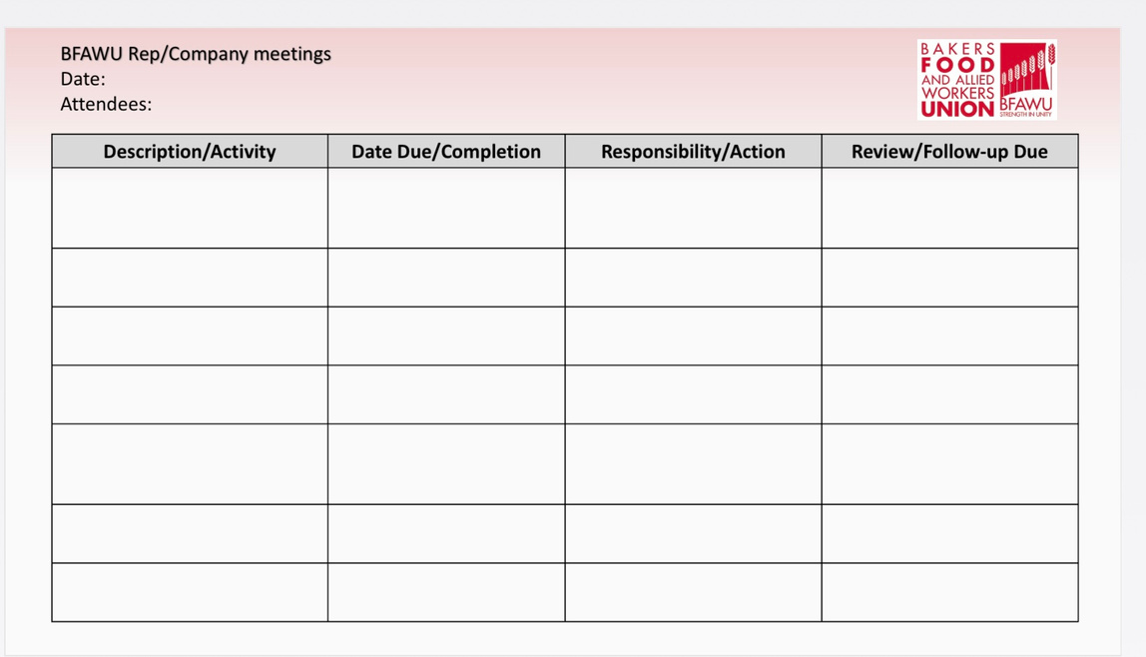
Meeting record/action template
To receive a copy of this template, please leave your email address at the end

Slide 3
Useful Reminders (maybe!)
Take time before any meeting to prepare yourself, reps group, member etc. If a member comes to request you to attend a hearing, reschedule if you have not been given enough time to prepare. You will be up against HR & management that will have taken the time to prepare themselves
Always take your own notes/minutes. Do not rely on the company for these, unless all minutes are agreed and signed off by all at the end of each meeting, then the company notes/minutes will be a reflection of their “interpretation“ of the meetings
Use dedicated Union notebooks, that are easily identifiable by you and always stored in a lockable facility and adhering to thee Unions GDPR policy
Use union notice boards, media platforms such as private WhatsApp/Facebook groups to feeedback all information to members

